Slide 1
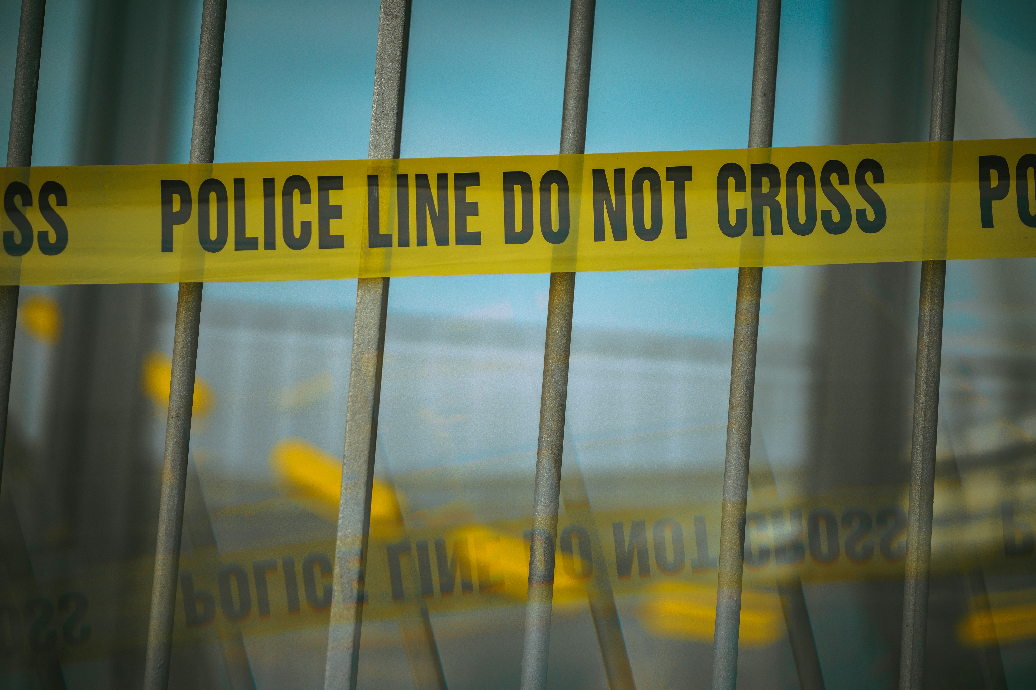
Custody File
Organization
A working system for family law paralegals
Jane Sparks, Senior Paralegal
Charlotte Paralegal Association CLE, October 24, 2026

Slide 2
Workshop agenda
1
Why organization decides outcomes
2
Building the matter folder, intake to filing
3
Tracking North Carolina deadlines
4
Exhibits, affidavits, and chronology
5
Mentoring the junior team

Slide 3
What lives in the matter folder
A consistent skeleton so any document is found in seconds
Current quarter, six open matters across four types

Slide 4
The CLE day and prep status
Time | Session
9:00 | Welcome and scope
9:30 | Building the matter folder
10:30 | Tracking North Carolina deadlines
11:30 | Exhibits, affidavits, chronologies
1:00 | Adoption documentation crossover
2:00 | Senior paralegal panel and Q and A
Run-through readiness
Slides and handout ready
80%
Files complete, 5 of 6 matters
83%
Final run-through with Trish on the Thursday before.

Slide 5
The unglamorous work wins cases
A clean file is the difference between a calm hearing and a scramble.

